Slide 1
SYSTEM DEVELOPMENT LABORATORY
Develop Micro Service and consume it using appropriate framework

Slide 2
What are Micro services?
Micro services are an architectural style that develops a single application as a set of small services.
It is a software engineering approach that focuses on decomposing an application into single-function modules with well-defined interfaces.
Each service runs in its own process.
The services communicate with clients, and often each other, using lightweight protocols, often over messaging or HTTP.
The term "micro" refers to the sizing of a microservice which must be manageable by a single development team ( 5 to 10 developers).

Slide 3
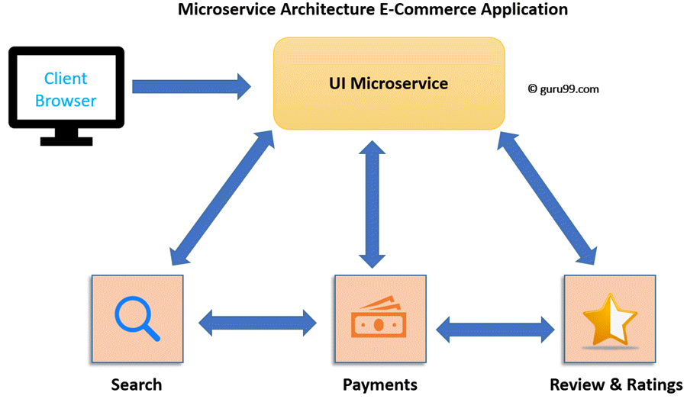
Micro service Architecture
Micro service Architecture is an architectural development style that allows building applications as a collection of small autonomous services developed for a business domain.
It is a variant of structural style architecture that helps arrange applications as a loosely coupled service collection.
The Micro service Architecture contains fine-grained services and lightweight protocols.

Slide 4
To-Do Manager: A super simple Micro services Example
Now, for building our Application, we will be making use of Python. Our application uses Flask as the framework for getting the basic things up.
Currently, the application uses a few files in the JSON format which serves as the database for our application.
For the time being, the application to most part is static in nature.
Currently, our application consists of two services namely the User service and the To-Do service:
User Service: The user service provides a RESTful endpoint to list the users in our application and also allows to query the user lists based on their usernames. This service currently runs on port 5000 of our server.
To-Do Service: The ToDo service provides a RESTful endpoint to list all the lists as well as providing the list of projects filtered on the basis of usernames. This service runs on port 5001 of our server.
The application can be located at ToDo Manager, feel free to clone, fork, modify, and extend.

Slide 5
Set up the development environment
As a personal preference, to use virtual environments for building different python applications since it removes the risk of messing up with the libraries globally on my development system.
Run the following command to get the virtual environment.
-> sudo dnf install python-virtualenv
The next step is to create our project directory
-> mkdir todo && cd todo
Now, let’s setup our virtual environment and install the required dependencies for our application:
-> virtualenv venv
The above command will create a virtual environment named venv under the application directory.

Slide 6
Continued…
Next, we need to install the dependencies for our application.
Our application is current dependent on two libraries – Flask and requests.
Here, Flask as I have introduced is a web framework and requests is a library which allows us to make HTTP requests.
Before installing the dependencies, we need to activate our virtual environment.
-> source venv/bin/activate
The above command activates our virtual environment and now we need to install the dependencies. Run the below commands to get the dependencies installed in our virtual environment.
-> pip install flask requests
So, now we are done with setting up our development environment.

Slide 7
Continued…
The next step is to setup our directory structure for the application.
Currently, our application has two directories namely database and services.
The database directory hosts the files containing some dummy data for the users and to-do lists made by the users.
The services directory holds the code for our individual services – in this case the user service and todo service.

Slide 8
Create a file named users.json under the database directory and add the following to the file:
{
"saurabh_badhwar": {
"id":1,
"name":"Saurabh Badhwar",
"verified":1
},
"aniket": {
"id":2,
"name":"Aniket Sharma",
"verified":1
},
"luckas": {
"id":4,
"name":"Luckas Friendel",
"verified":0
}
}

Slide 9
The next thing we have to do is create another file named todo.json which contains the data of our lists. Create the file and add the following data to it:
{
"saurabh_badhwar": {
"home": [
"Buy milk",
"Look for pest control service",
"Get a new carpet"
],
"work": [
"Complete the blogpost",
"Create presentation for meeting"
]
},
"aniket": {
"school": [
"Complete homework",
"Prepare for test"
]
}
}
So, now we are done with the database part for our application.

Slide 10
Under the services directory, create a file named users.py and write the code for it:
Next, we have to build our services. So, let’s start with writing our User service.
from flask import Flask, jsonify, make_response
import requests
import os
Import simplejson as json
The next we do is to initialize our flask service
-> app = Flask(name)
Now, we import our users database in the service and parse it as a JSON file
-> with open("{}/database/users.json".format(database_path), "r") as f: usr = json.load(f)

Slide 11
A simple hello world entrypoint can be created as:
The next step is to write our application endpoints,
@app.route("/", methods=['GET'])
def hello():
''' Greet the user '''
return "Hey! The service is up, how about doing something useful“
The @app.route helps set the application route.
The above example helps us setup a hello world application point.
When a user visits our application at http://localhost:5000 the user will be greeted with the message we have specified.

Slide 12
Continued…
The final step in writing the service will be to run the server as soon as the application is called.
This can be achieved by the following set of code for our user micro service.
if __name__ == '__main__':
app.run(port=5000, debug=True)
For the To-Do service and rest of the code for the User service, you can look up the repository.

